Slide 1

Notes:
PLEASE NOTE THE FOLLOWING USAGE REQUIREMENTS FOR THE FIRST® DIVESM presented by Qualcomm template.
Presentations using this deck must include the FIRST DIVEcover slide (Slide 1) to ensure recognition of our presenting sponsor, Qualcomm.
Do not modify the template or overlap any of the built-in graphics.
This template uses the Roboto font family, which can be downloaded for free at fonts.google.com/specimen/Roboto
Any text use of FIRST should be in italics. Please see the FIRST Brand & Design Guidelines for more: www.firstinspires.org/brand

Slide 2

SUBMERGEDSM Awards Ceremony
Qualifier Tournament 2024

Slide 3
Thank-yous

Slide 4


Slide 5

Local Sponsor
Builders of Tomorrow – The FIRST Northeast Florida Program Delivery Organization

Slide 6
Thank you to our Volunteers!!!!!

Slide 7
Volunteer Award

Slide 8
Volunteers
No tournament can happen without the support, time, and commitment of our volunteers!

Slide 9
The Volunteer Award goes to:
{Volunteer Award}

Slide 10
The Coach/Mentor Award

Slide 11
The Coach/Mentor Award
Coaches and mentors inspire their teams to do their best, both as individuals and together, and without them, there would be no FIRST LEGO League. This award goes to the coach or mentor whose leadership and guidance is clearly evident and best exemplifies the FIRST Core Values.

Slide 12
The Coach/Mentor Award goes to:
{Coach/Mentor Award}

Slide 13
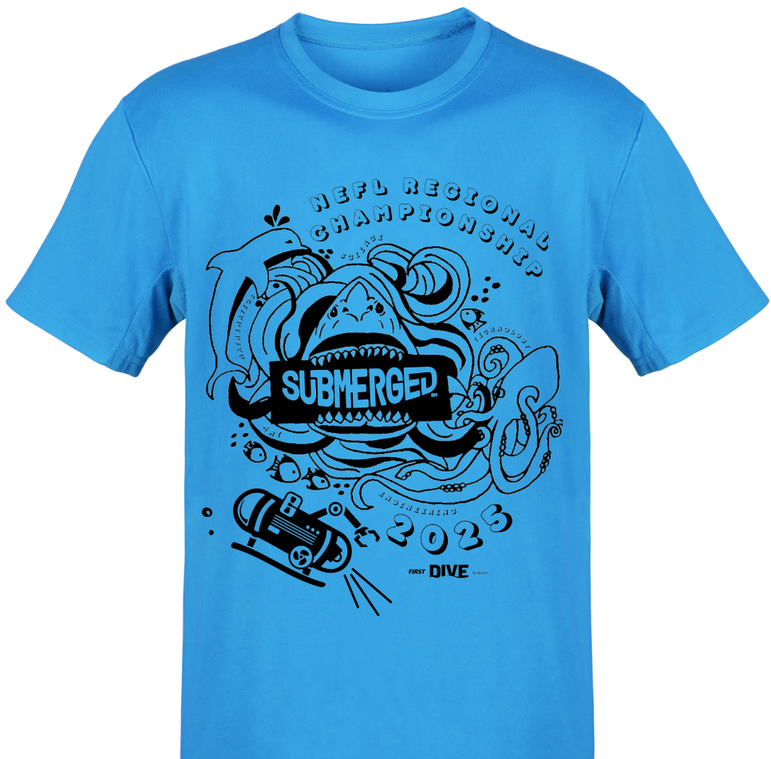
T-Shirt Design Winner
We asked teams to enter a T-Shirt Design for the Regional Championship…
This season’s winner is
Doc Bots (66269)
The team wins an invitation to the Regional Championship, Friday/Saturday January 17th & 18th Legacy Park Multipurpose Center in Alachua, Florida

Slide 14
Breakthrough Award

Slide 15
Breakthrough Award
This award celebrates a team that made significant progress in their confidence and capability in both the Robot Game and Innovation Project and are a shining example of excellent Core Values. They demonstrate that they understand that what they discover is more important than what they win.

Slide 16
The Breakthrough Award goes to:
{Breakthrough Award}

Slide 17
Engineering Excellence Award

Slide 18
Engineering Excellence Award
This award celebrates a team with an efficiently designed robot, an innovative Project solution that effectively addresses the season Challenge, and great Core Values evident in all they do.

Slide 19
The Engineering Excellence Award goes to:
{Engineering Excellence Award}

Slide 20
Rising All-Star Award

Slide 21
Rising All-Star Award
This award celebrates a team that the judges notice and expect great things from in the future.

Slide 22
The Rising All-Star Award goes to:
{Rising All-Star Award}

Slide 23
Motivate Award

Slide 24
Motivate Award
This award celebrates a team that embraces the culture of FIRST LEGO League through team building, team spirit, and displayed enthusiasm.

Slide 25
The Motivate Award goes to:
{Motivate Award}

Slide 26
Innovation Project Award

Slide 27
Innovation Project Award
This team utilized diverse resources for their Innovation Project to help them gain a comprehensive understanding of the problem they identified, developed a creative, well-researched solution and effectively communicated their findings to judges and the community.

Slide 28
The Innovation Project Award goes to:
{Innovation Project Award}

Slide 29
Robot Design Award

Slide 30
Robot Design Award
This team used outstanding programming principles and solid engineering practices to develop a robot that is mechanically sound, durable, efficient and highly capable of performing Challenge missions.

Slide 31
The Robot Design Award goes to:
{Robot Design Award}

Slide 32
Robot Performance Award

Slide 33
Robot Performance Award
This award celebrates a team that scores the most points during the Robot Game. Teams have a chance to compete in at least three 2.5-minute matches and their highest score counts.

Slide 34
The Robot Performance Award goes to:
Team:
{Robot Performance Award}
High Score:
{Robot Performance Score}

Slide 35
Core Values Award

Slide 36
Core Values Award
This award celebrates a team that displays extraordinary enthusiasm and spirit, knows they can accomplish more together than they could as individuals, and shows each other and other teams respect at all times.

Slide 37
The Core Values Award goes to:
{Core Values Award}

Slide 38
Champion’s Award

Slide 39
Champion’s Award
This most prestigious award celebrates the team that embodies the FIRST LEGO League experience by fully embracing the FIRST Core Values while achieving excellence and innovation in both the Robot Game and the Innovation Project.

Slide 40
The Champion’s Award goes to:
{Champion’s Award}

Slide 41

Team ADVANCEMENTS
5 Teams will receive bids to advance to the Northeast Florida Regional Championship on January 17th & 18th 2025 TODAY!
From Regionals, 23 Teams will advance to the FLORIDA STATE CHAMPIONSHIP FEBRUARY 8TH 2025
From the Florida State Championship:
2 Teams will advance to World Festival in Houston April 16th - 19th 2025
1 Team will advance to the Open Africa Championship in South Africa May 7 - 9 2025
1 Team will advance to Western Edge Open in California May 30 - June 1 205
5 Teams will advance to Florida Sunshine Invitiational in Daytona FL (1 guaranteed NEFL bid) June 24-28 2025
One alternative bid will be given out today.

Slide 42
Teams advancing to the Northeast Florida Regional Championship
Congratulations to teams:
Alternate Bid
{Advancing Team 1}
{Alternate Team}
{Advancing Team 2}
{Advancing Team 3}
{Advancing Team 5}
{Advancing Team 4}

Slide 43
Collect your rubrics!
Pick them up at the Front Desk

Slide 44
Congratulations, Teams!
We hope to see you at the
NORTHEAST FLORIDA REGIONAL CHAMPIONSHIP
January 17th & 18th 2025
Legacy Park Sports Complex, Alachua, FL

